Slide 1
Time-Series Forecasting for NASDAQ Index
Xinyue Liu, Chelsea Wang, Jiaqi Hu, Qiaowei Jiang, Ju Huang

Slide 2

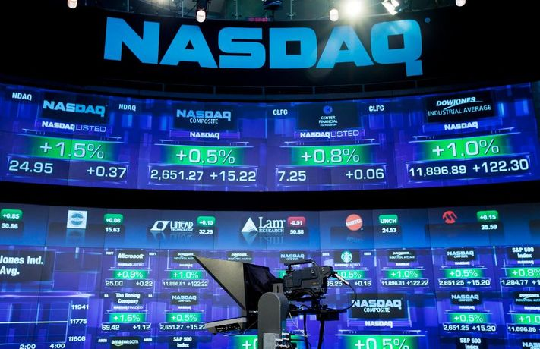
Introduction
Forecast NASDAQ Composite Index
Stock Market Index
affects the interests of investors
interacts with country's macroeconomic policies
NASDAQ Composite Index
one of the most widely-watched indexes in the world
a stand-in for the technology sector
launched in 1971, with a starting value of 100
Models:
ARIMA, GARCH, LSTM
Regressor: Interest Rate
Goal of this project:
find the best model for prediction
help investors to evaluate market performance
help practitioners to forecast technical industry’s trend of development

Slide 3
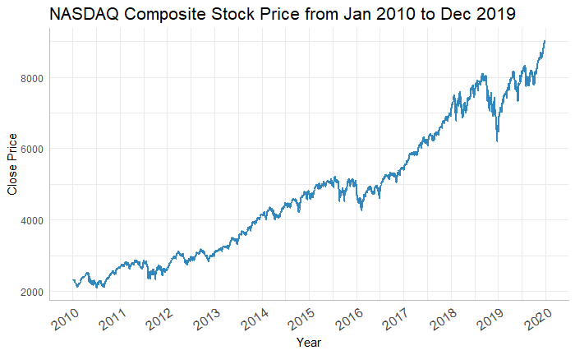
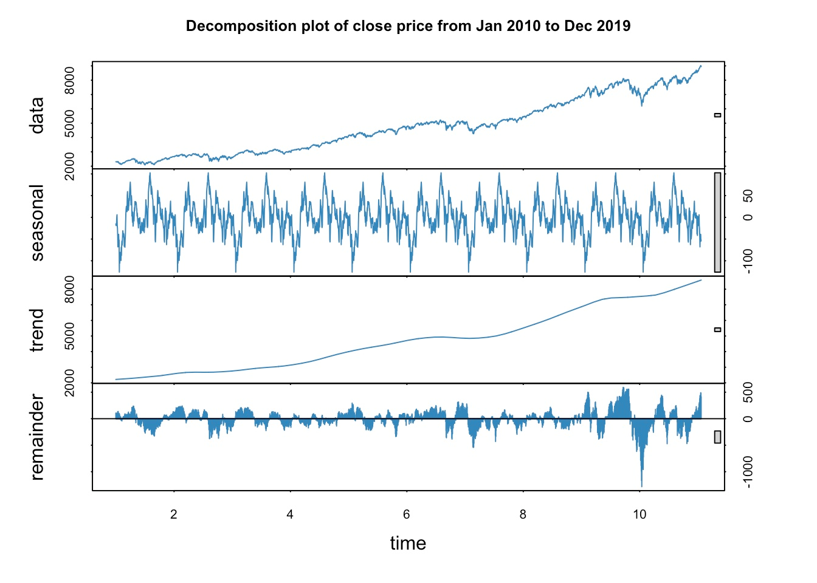
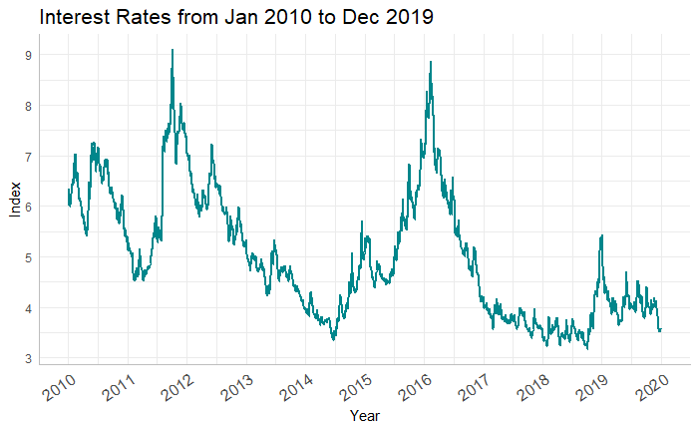
Data (EDA)
Nasdaq Composite Close Price (2010-2019, Yahoo Finance, daily data)
Interest Rate (2010-2019, Federal Reserve Bank of St.louis, daily data)

Slide 4
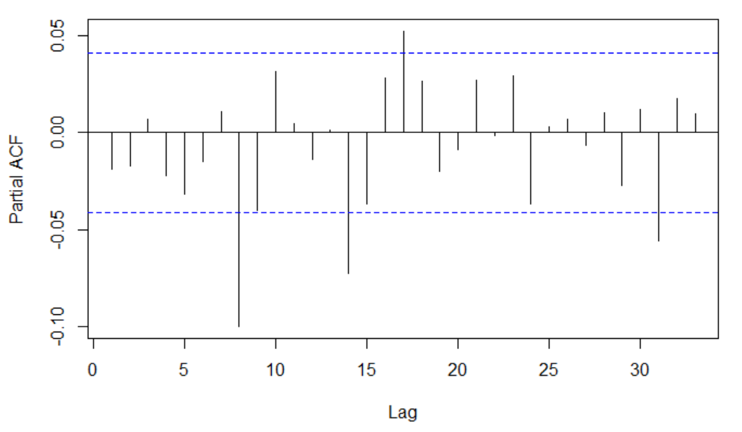
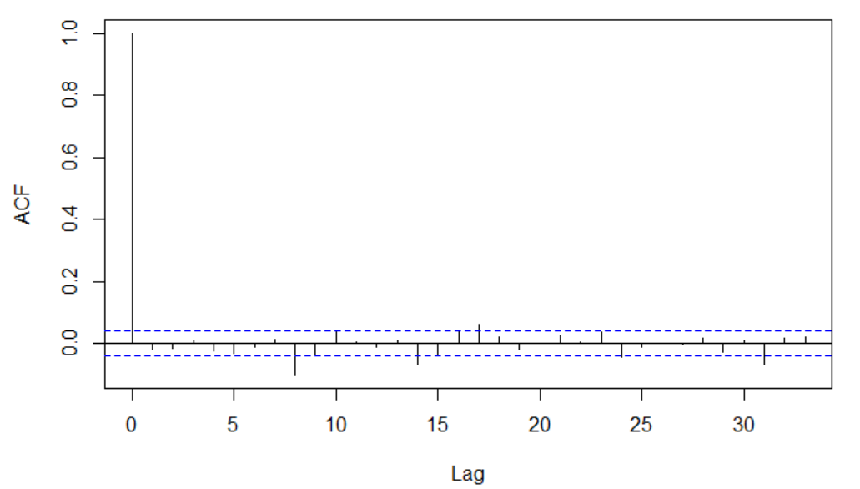


ARIMA
Compare the significance of coeffs
PACF: AR term may equals to 0,1 or 2
ACF: MA term may equals to 0,1 or 2
The AIC for fit1 is 23959.22 ; The BIC for fit1 is 23970.67
The AIC for fit2 is 23962.40 ; The BIC for fit2 is 23985.29
The AIC for fit3 is 23963.72 ; The BIC for fit3 is 23970.67
The AIC for fit4 is 23961.74 ; The BIC for fit4 is 23984.63
The AIC for fit5 is 23963.74 ; The BIC for fit5 is 23992.36
The AIC for fit6 is 23955.89 ; The BIC for fit6 is 23990.24
ARIMA(0,1,0) VS ARIMA(2,1,2)
ARIMA(2,1,2)

Slide 5
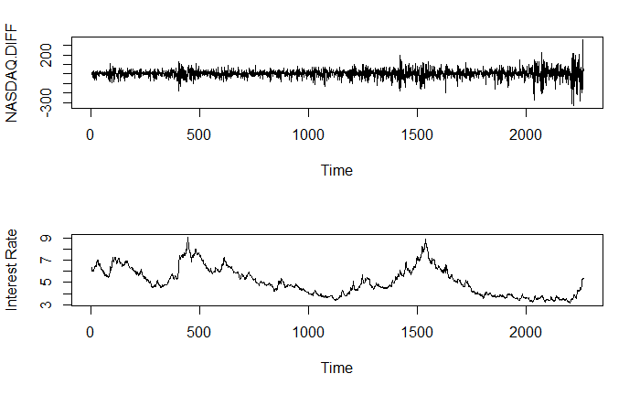
ARIMA+Regressor
ARIMA (4,1,1)
 | AIC | BIC
ARIMA.Auto ARIMA(2,1,2) | 23955.89 | 23990.24
ARIMA+Regressor ARIMA(4,1,1) | 23473.71 | 23519.51
Notes:
Based on a purpose of further improve our model, we consider adding on a regressor -- INTEREST RATE, which is closely related to the stock price.
From the plots above, we can see that the difference of NASDAQ index and the interest rate almost fluctuate at the same time.
Again, we use auto.arima function to gives us the better approach to the dataset, so we will not deep the analysis on finding model parameters here. The result model is ARIMA(4,1,1).
Compared with the previous best ARIMA model, the ARIMA model with regressor has both smaller AIC and BIC. So adding a regressor benefits the performance of our model.

Slide 6
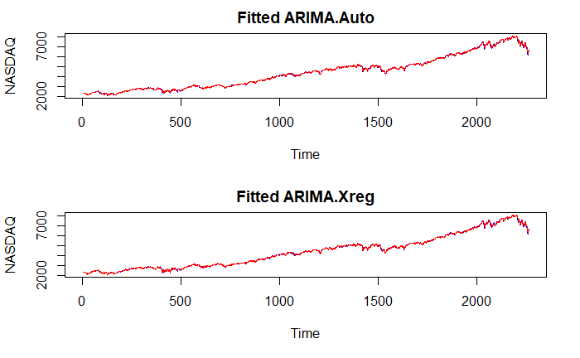
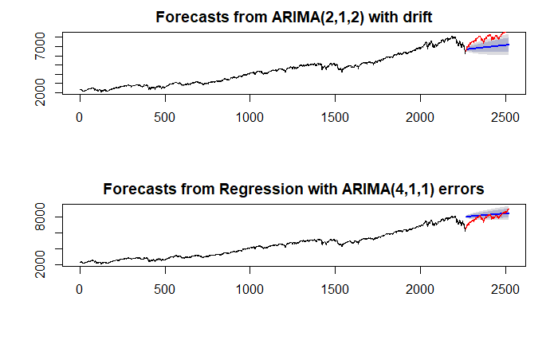
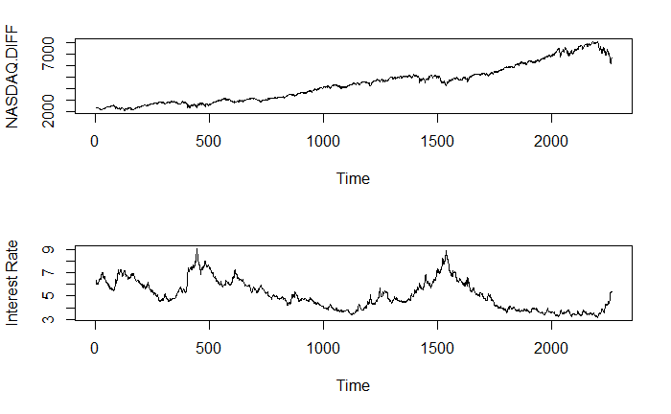
ARIMA+Regressor
 | RMSE
ARIMA.Auto ARIMA(2,1,2) | 1075.001
ARIMA+Regressor ARIMA(4,1,1) | 452.421
Notes:
Having our ARIMA models applied and analysed we can plot the model prediction in a red line over the real train set stock close price in blue.
Both plots indicate that our models fit the actual data quite well. We need to remind that these are auto regressive models, so we are going to have very good past predictions. Now with the model fitted we can proceed to forecast our daily close price values to the future. We focus on forecasting the close Nasdaq index for the next year, 2019.
As we can see, we have a blue line that represents the mean of our prediction, a red line that represents the actual data in 2019. With the blue line explained we can see a darker and light darker areas, representing 80% and 95% confidence intervals respectively in lower and upper scenarios.
Both models indicate an upward trend. There is a downward trend at the end of the training data. The first model is affected by this and gives a lower prediction in 2019. While our second model overcomes this misleading information and gives a relevantly accurate prediction, much better than the first one. The RMSE of prediction results also show this.
When Nasdaq index descended in late 2018, the interest rate get on an upward trend. We can assume that this wave of stock descending came from the increase of interest rate. As the interest rate would be adjusted in the near future --it's impossible to increase all the time -- the stock price would quickly get back to its way in increasing.

Slide 7
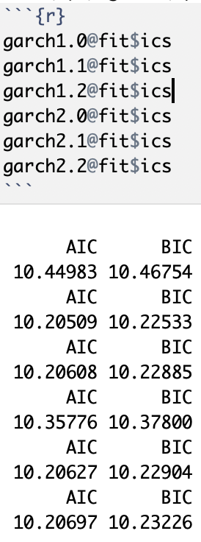
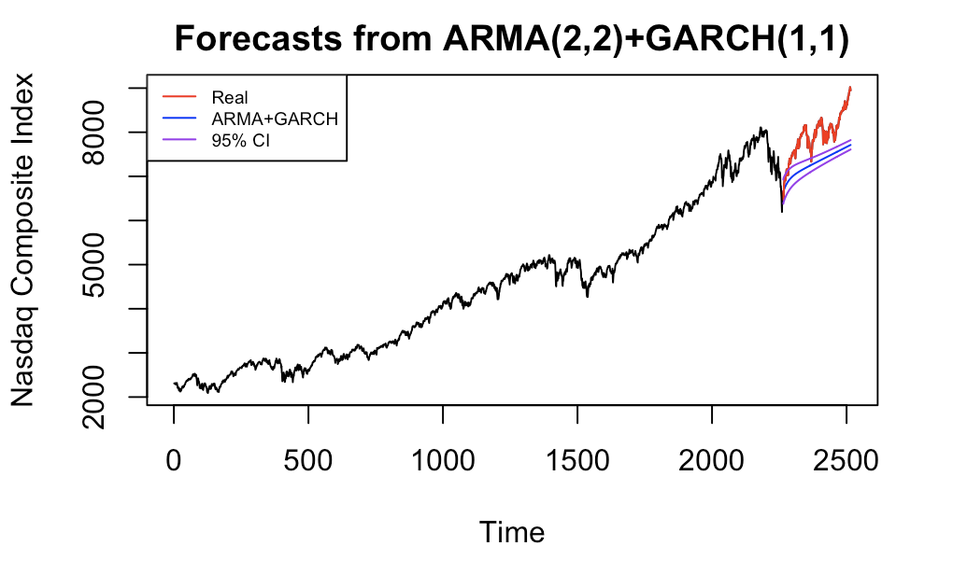
ARMA+GARCH
Notes:
We have also tried another approach: GARCH to improve the performance of the ARIMA model. Since our ARIMA model is ARIMA(2,1,2) with d = 1, but the GARCHfit function can only take ARMA model as its base model, we need to first difference the original data and then apply ARMA(2,2) and GARCH model to it. Here we tried all GARCH(p,q) models with p equals to 1 or 2, and q equals 0, 1 or 2. Among the 6 models, GARCH(1,1) has the smallest AIC and BIC values, and thus we choose GARCH(1,1) to add to ARMA(2,2) model for prediction. After the prediction is done, we then convert the predicted values by inverse the differencing process, and then we get the forecast plot for the model. Because GARCH model takes variance into account, it add curvature to the simple straight line forecast of ARIMA model and it looks closer to the real data than basic ARIMA model.

Slide 8
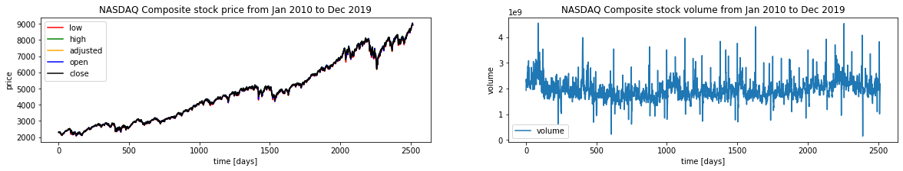
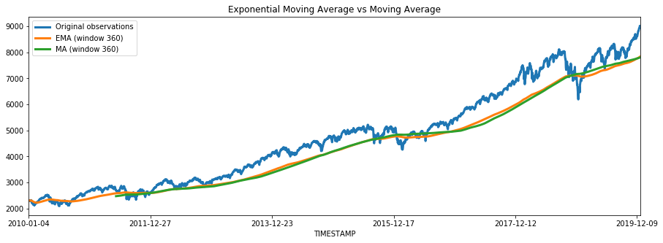
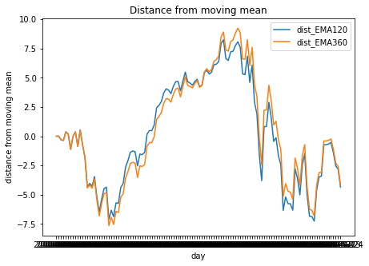
LSTM Data Prepare
Notes:
In this section, I applied a Long Short-Term Memory network to improve the model’s performance. An LSTM model is an improved version of recurrent neural networks, which is similar to human learning. When humans think, we don’t start our thinking from scratch each second. For example, in the sentence “Bob plays basketball”, we know that Bob is the person who plays basketball because we retain information about past words while reading sentences. Similarly, RNNs are networks with loops in them, which allow them to use past information before arriving at a final output. However, RNNs can only connect recent previous information and cannot connect information as the time gap grows. This is where LSTMs come into play; LSTMs are a type of RNN that remember information over long periods of time, making them better suited for predicting stock prices.
Before I dive into the model, let me introduce some data preparation methods that I did to improve the performance. Since LSTM recurrent neural networks are able to take in multiple input variables, I also look at open, close, low, high, adjusted price and volume from stock data with interest rate as we discussed before. From the plots we can see that there is barely any difference among these prices, but the volume seems to be an insightful variable to be included in the model.
Secondly, I smoothed the closing price data using a moving average and exponential moving average. This helps us to get rid of the inherent raggedness of the data in stock prices and produce a smoother curve.
From the plot, you can see an exponential moving average with an orange line that catches the downwards movement in Dec 2018 faster than the moving average with the green line. Also, in early 2016, an exponential moving average started to catch an upwards movement, while the moving average still showing a downwards trend. To better catch the trend of a stock price, I decided to use the distance from the exponential moving average mean as an additional feature in the analysis.

Slide 9
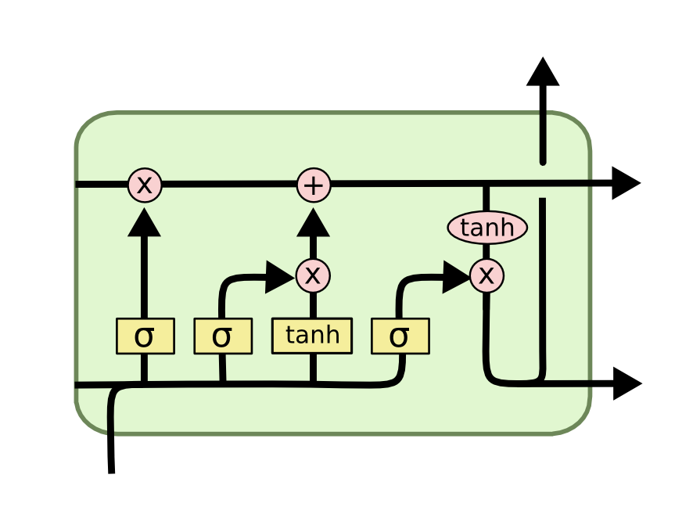
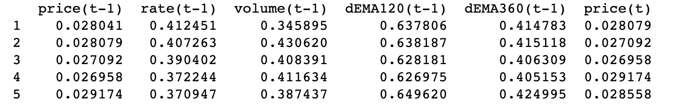
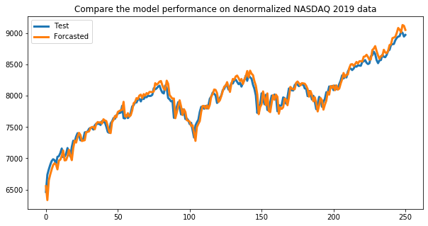
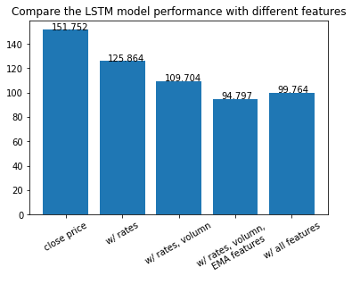
LSTM
Notes:
In the model, we frame the supervised learning problem as predicting the closing stock price at the current day given all the features of the prior day. We feed in different features from our selections to compare how they work. From the bar plot, we can see that the model with the interest rate is better than the one without. Ultimately, the best model is the one with interest rate, volume, and two features generated by the exponential moving average. In the line plot we can see how well it fits in with 2019 data.

Slide 10
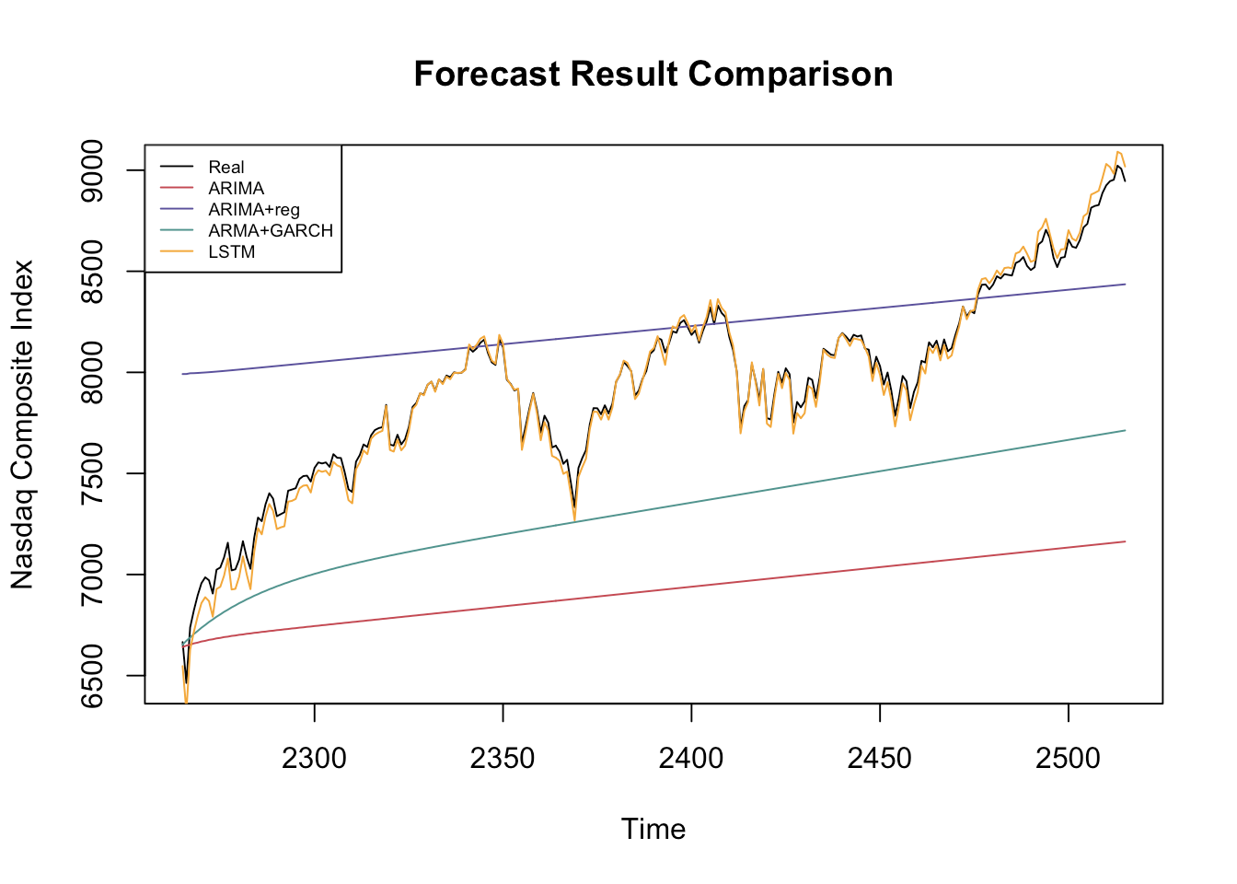
Model Prediction Result Comparison
Model | RMSE
ARIMA | 1075.001
ARIMA + Regressor | 452.421
ARMA + GARCH | 683.996
LSTM | 94.797
Notes:
Here is the plot of all the models we used and their prediction. The black line is the real data, red line is prediction made by the basic ARIMA model, purple line is ARIMA model with regressor, green line is the basic ARMA model adding the GARCH model, and the orange line is LSTM model. The ARIMA model is the most straightforward and interpretable one and it can be widely used. By adding regressor to the ARIMA model, if the regressor is quite correlated, the result can be improved a lot. However, the ARIMA model we learned, with or without regressor can only forecast an approximate straight line with drift, and in most cases cannot reflect the trend and volatility. By adding GARCH model to it, we can better predict the trend b/c it takes variance into account and it is not limited to a straight line anymore. However, all these time series models can only predict the general trend. If we open our mind and think about step-wise deep learning models, for example, LSTM, it has very high flexibility and it can learn and train itself. An advantage of LSTM is: it is non-linear function with neural network so it works very well for fluctuate series like our data. We also calculated RMSE of all the models to evaluate and compare the performance of all these models. As we can see from the table on the right, the RMSE of basic ARIMA model is about 1000, regressor and GARCH models are in the middle with RMSE of about 400 to 600, and LSTM’s RMSE is amazing, which is only ...

Slide 11

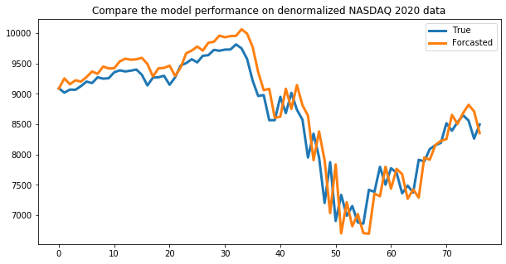

Conclusion
Notes:
Since the LSTM model gave the best performance on our test set, we wanted to go one step further to see how it worked on the NASDAQ closing stock price for 2020. However, RMSE of this period time is way worse than that of 2019. As many of you are aware, the current COVID-19 pandemic has created lots of uncertainty, especially in the global economy. As such, the model didn’t pick up on such a large external factor for its prediction but appears to perform not terrible in terms of the overall trend.
Overall, the final LSTM model performed well with the NASDAQ data. It would be interesting to see how the model would work with other stock datasets like the Dow Jones. Also the model could maybe be improved by adding in other external factors that may impact stock data; such as news sentiment data.
That’s the end of our presentation. Any question?

